Slide 1

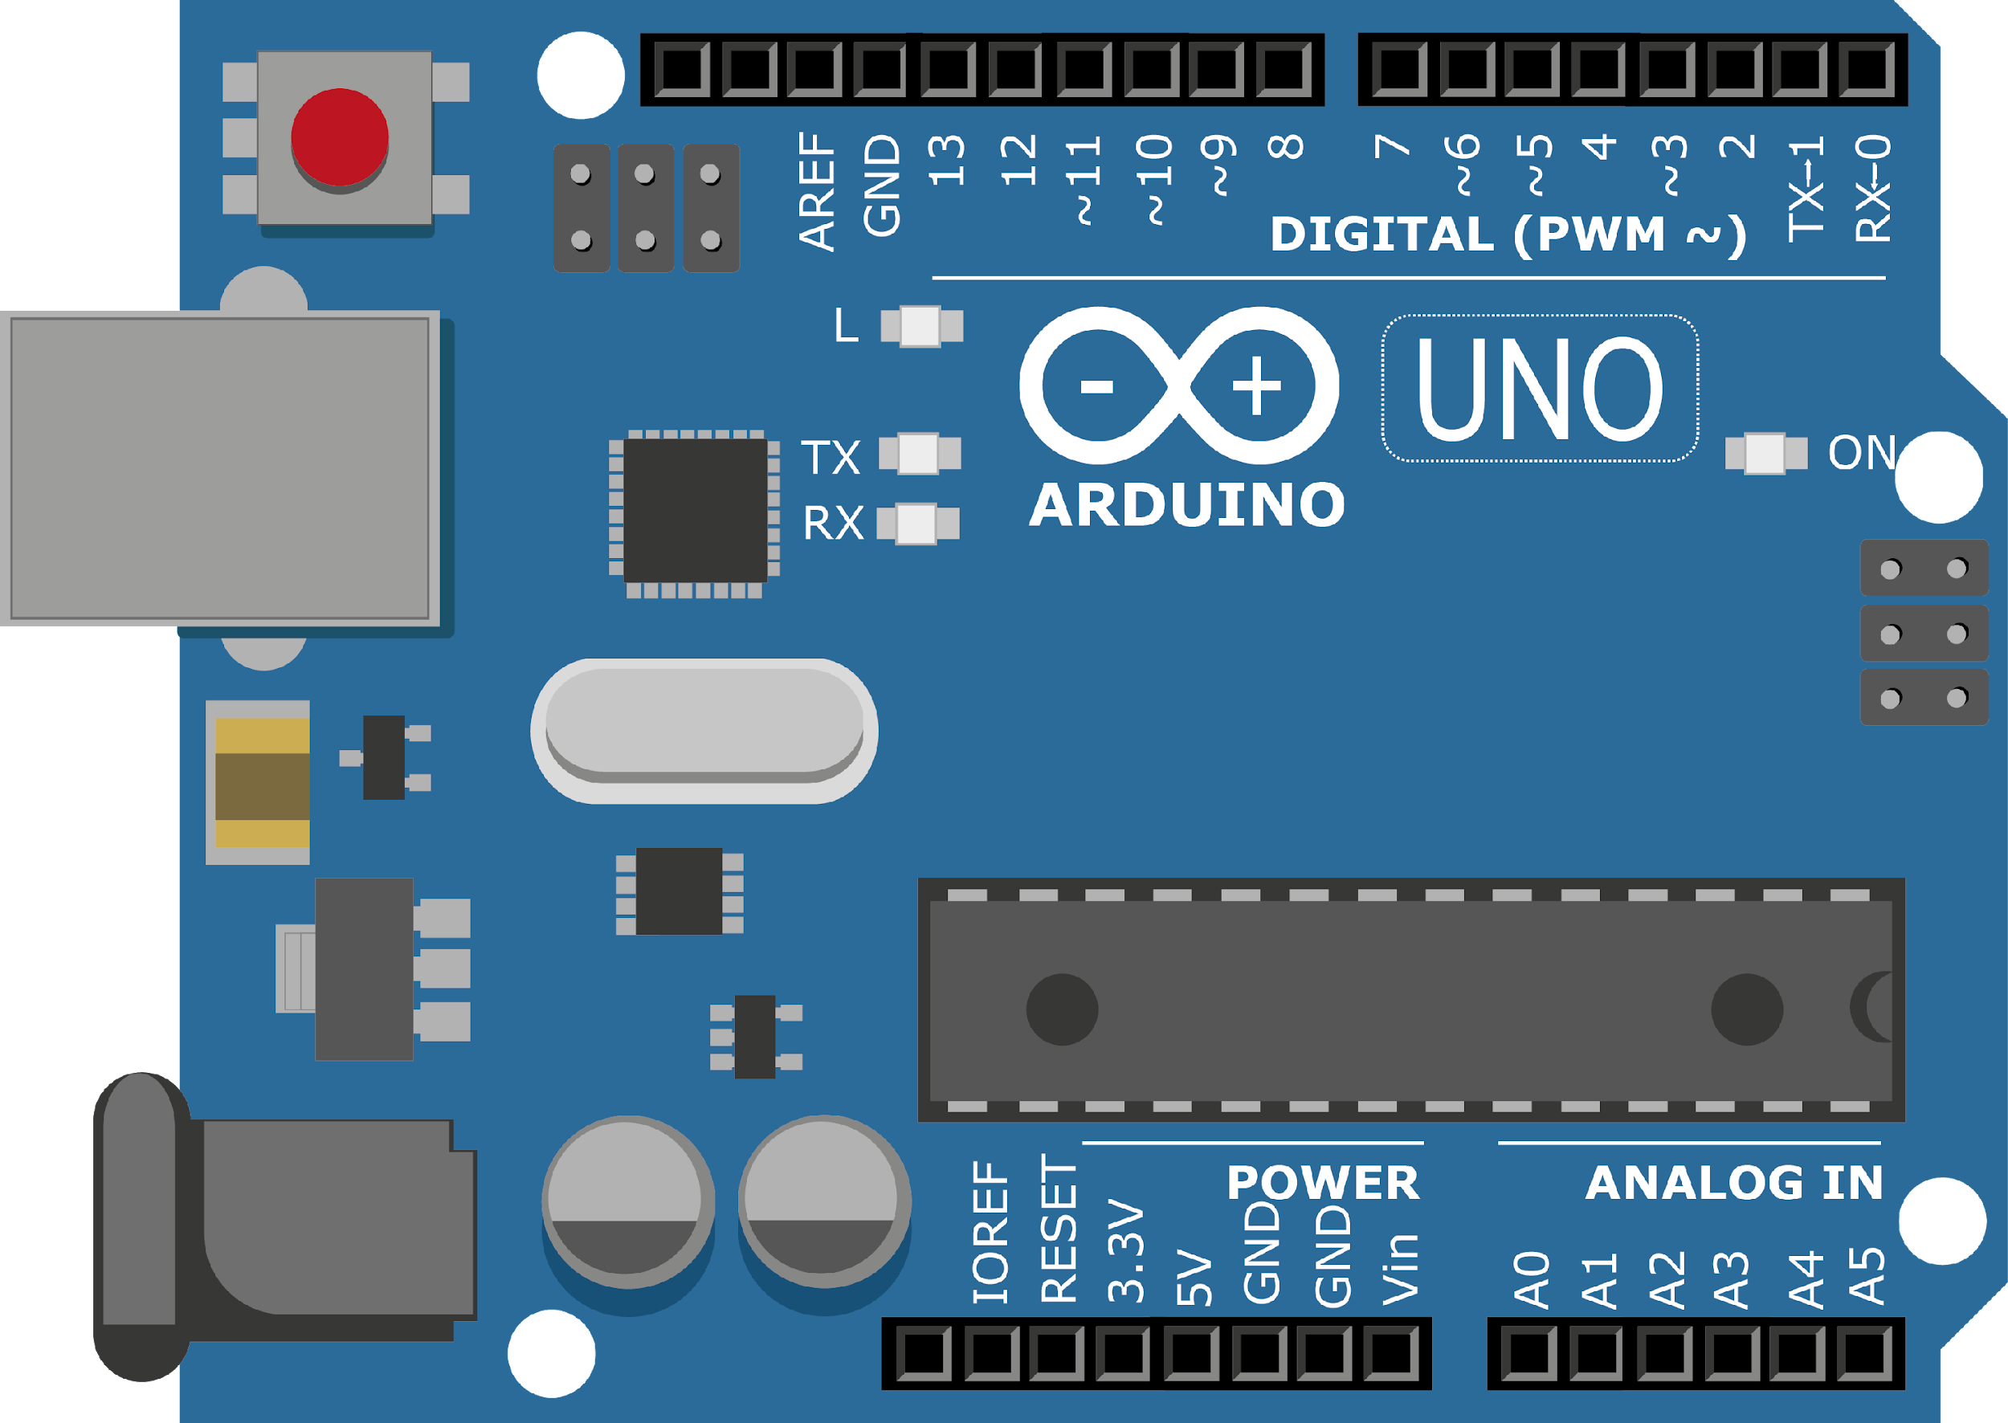
ARDUINO MASTER CLASS
12
Bluetooth & Voice controlled robot using Arduino

Slide 2
12 AGENDA
02
03
01
Bluetooth Controlled Robot
Robot Design
Q & A

Slide 3
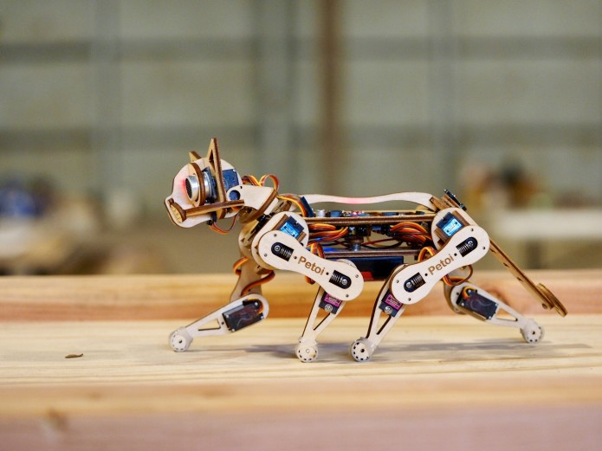
Robot Design
Mechanisms
Electronics
Programming
Fabrication
Environment
Power
Senses
Body/Chassis & Material
Style

Slide 4
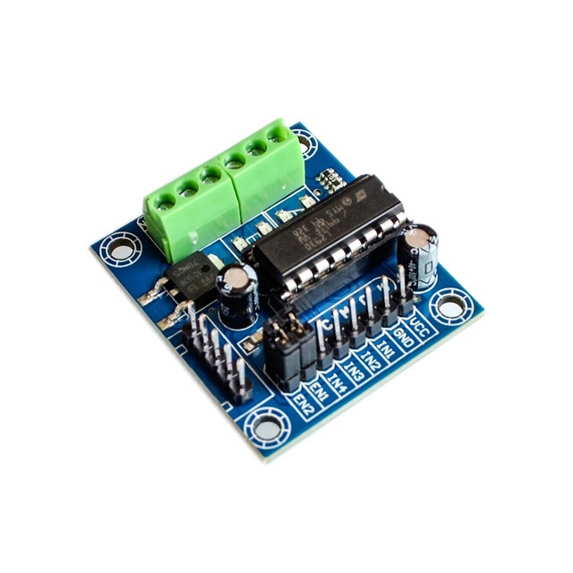
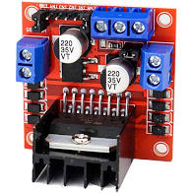
L293D or L298N– Motor Driver
L293D is a typical Motor driver or Motor Driver IC which allows DC motor to drive on either direction. L293D is a 16-pin IC which can control a set of two DC motors simultaneously in any direction. It means that you can control two DC motor with a single L293D IC.

Slide 5
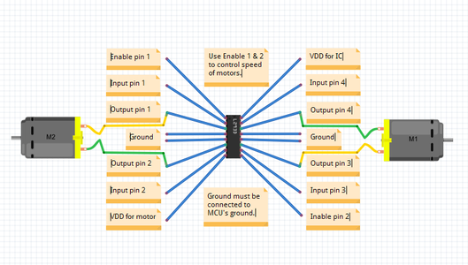
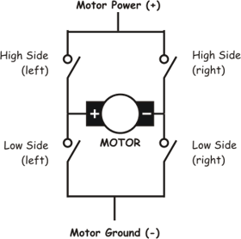
L293D Pinout

Slide 6
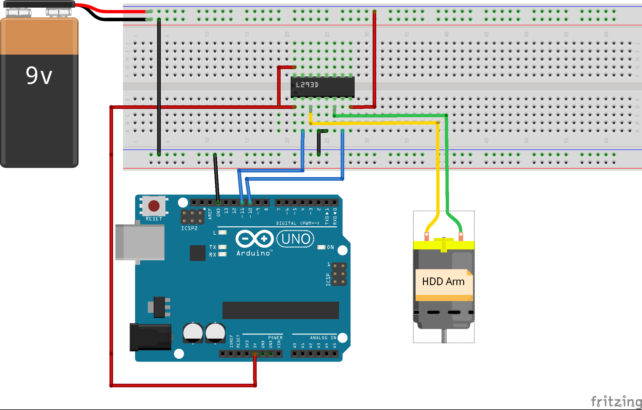
L293D with Arduino

Slide 7
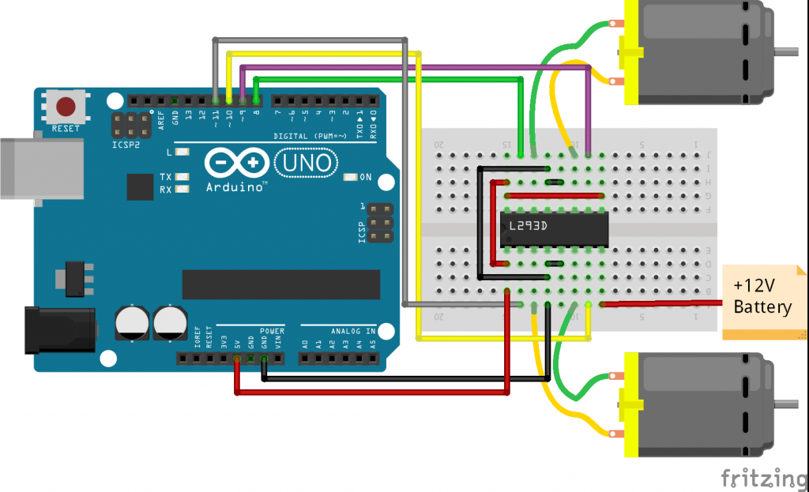
Robotic Car – Circuit diagram

Slide 8

INTERVIEW QUESTIONS
Oscillator
What is a Transformer
What is Modulation?
An oscillator is an electronic circuit which generates a periodic AC signal from a DC source. The output of oscillator can be sinusoidal or Square or a triangle wave
The process in which one of the characteristic parameter (amplitude, frequency, phase) of the carrier signal varies linearly with respect to message signal’s amplitude is called modulation.
A transformer is a static electrical device which transfers electrical energy from one circuit to another circuit without any physical connection instead it uses the principles of electromagnetic induction. A transformer either increase or decrease the input voltage & current.

Slide 9

THANKS!

